Slide 1
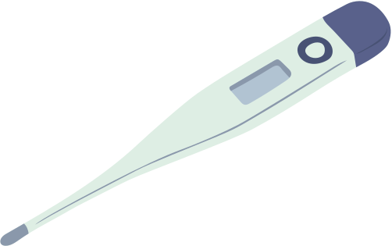
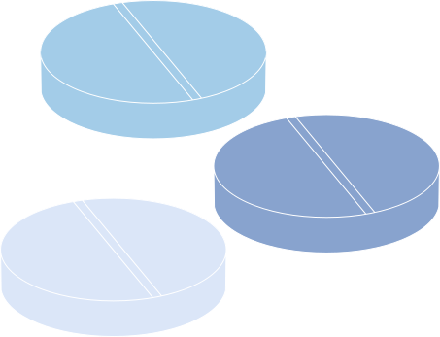




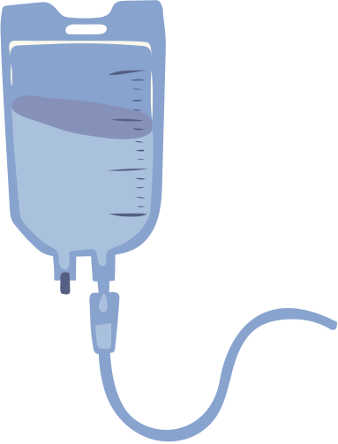


Medical expert Diagnosis System
Name:Fatema Afsan Ema
ID:2022281642
Name:Md Mashikur Rahaman
ID:2011033642
Name:Rakibul Hasan Ridoy
ID:1731339042
Name:Nafsi Omar Prokrety
ID:2022326642
Name:Md Mehidi Hasan Khan
ID:2013957642

Slide 2





Significance:
Problem:
Misdiagnosis, limited expert availability, need for AI support.
Goal:
Assist healthcare professionals in making faster, explainable diagnoses
Fatema Afsan Ema ID:2022281642 Md Mashikur Rahaman ID: 201103364 Rakibul Hasan Ridoy ID:1731339042
Nafsi Omar Prokrety ID:2022326642 Mehidi Hasan Khan ID:2013957642

Slide 3









INTRODUCTION
The Medical Diagnosis Expert System is an AI-driven tool designed to assist healthcare professionals in diagnosing diseases based on patient symptoms and medical history. It uses artificial intelligence (AI) techniques, mainly expert systems and rule-based reasoning, to simulate the decision-making ability of human medical experts.
The system works by collecting patient information such as symptoms, medical history, and test results. It then applies its knowledge base (containing medical facts, rules, and past case data) along with an inference engine (the reasoning mechanism) to analyze the input and suggest possible diagnoses or medical advice.
Name:Fatema Afsan Ema ID:2022281642 Name:Md Mashikur Rahaman ID: 201103364 Name: Rakibul Hasan Ridoy ID:1731339042
Name:Nafsi Omar Prokrety ID:2022326642 Name:Mehidi Hasan Khan ID:2013957642

Slide 4
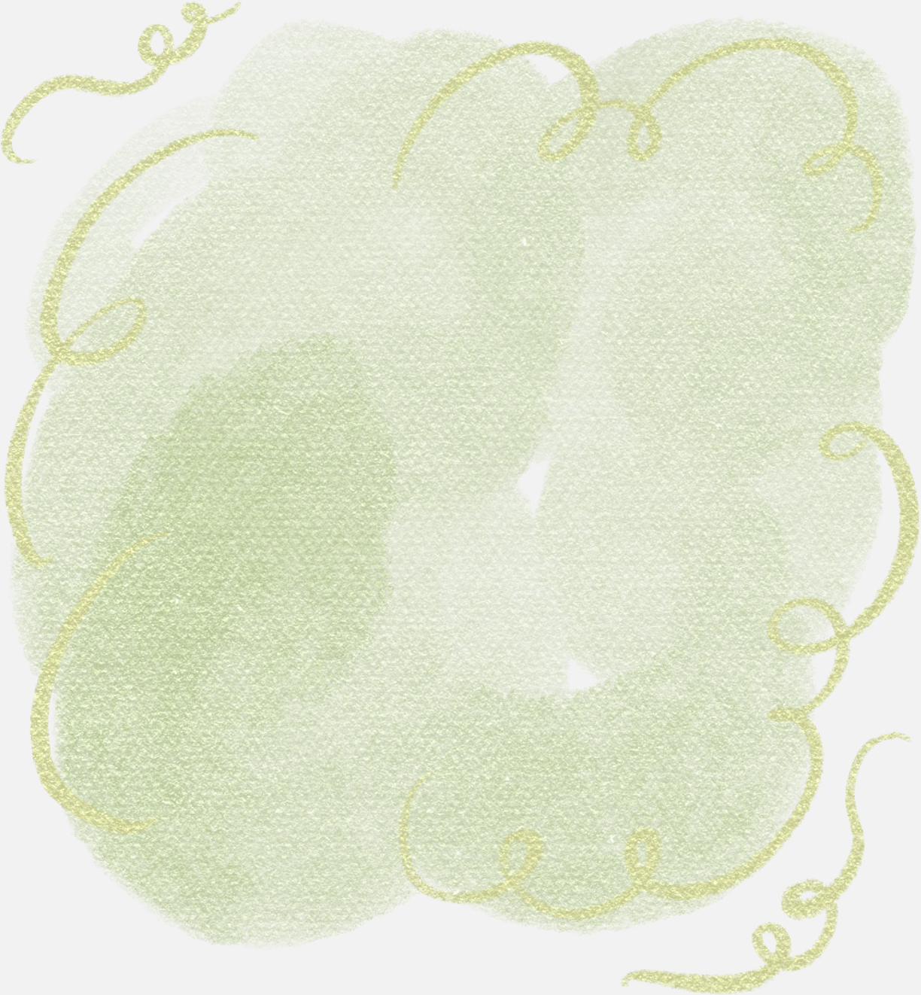

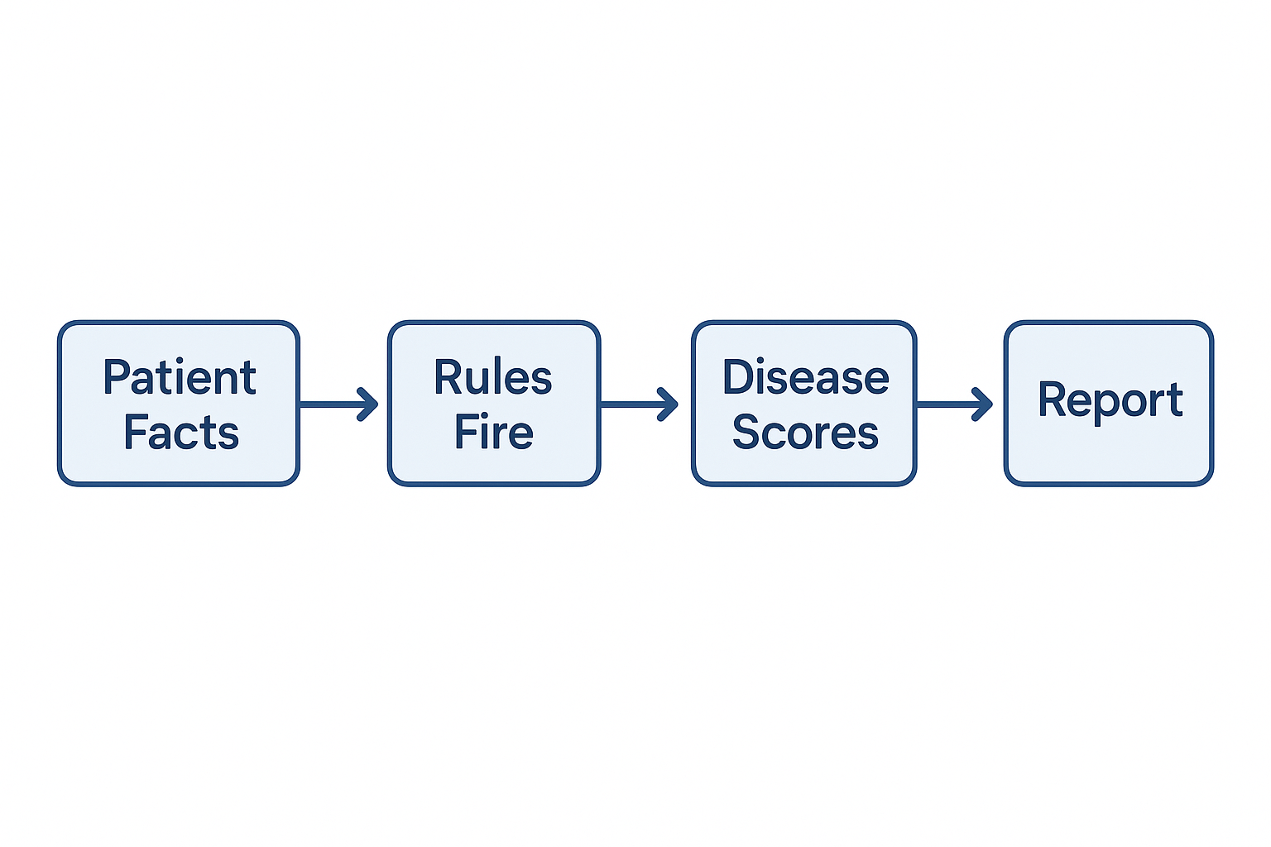

CORE IDEA
Core Workflow of the system:
1. takes patient facts such as symptoms, risk factors, and lab results.
2. It applies medical rules.
3. If rules fire, they increase the certainty score of diseases.
4.the system generates a report with possible diagnoses, explanations, and test recommendations.
Name:Fatema Afsan Ema ID:2022281642 Name:Md Mashikur Rahaman ID: 201103364 Name: Rakibul Hasan Ridoy ID:1731339042
Name:Nafsi Omar Prokrety ID:2022326642 Name:Mehidi Hasan Khan ID:2013957642

Slide 5




Knowledge Representation
Diseases stored with:
Typical symptoms
Risk factors
Tests
Red flags
Rules connect these features to diseases using IF–THEN logic.
Rules: IF–THEN with certainty weights
Name:Fatema Afsan Ema ID:2022281642 Name:Md Mashikur Rahaman ID: 201103364 Name: Rakibul Hasan Ridoy ID:1731339042
Name:Nafsi Omar Prokrety ID:2022326642 Name:Mehidi Hasan Khan ID:2013957642

Slide 6
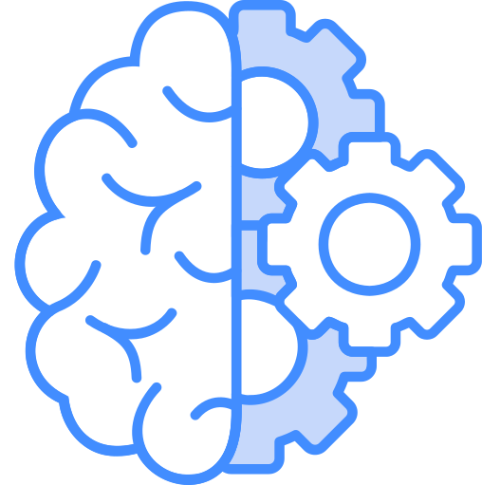

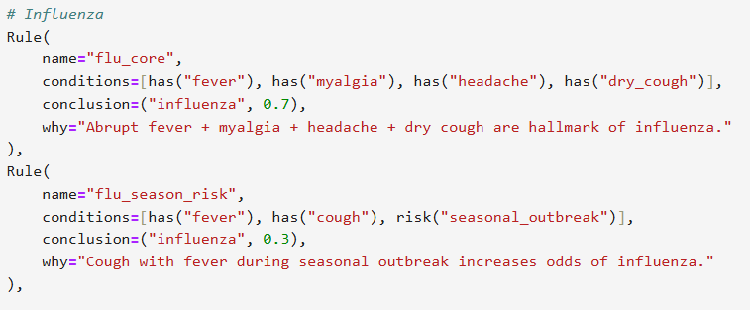
Logic Programming & Rules
Example Rule:
IF fever + myalgia + headache + dry cough
THEN Influenza (certainty = 0.7)
Name:Fatema Afsan Ema ID:2022281642 Name:Md Mashikur Rahaman ID: 201103364 Name: Rakibul Hasan Ridoy ID:1731339042
Name:Nafsi Omar Prokrety ID:2022326642 Name:Mehidi Hasan Khan ID:2013957642

Slide 7
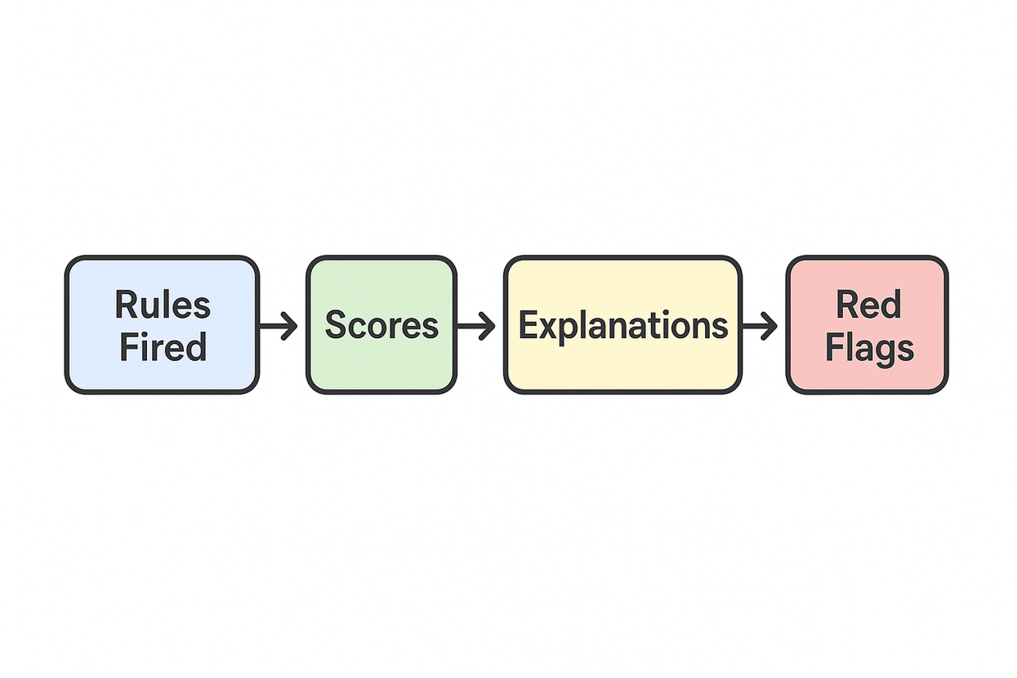

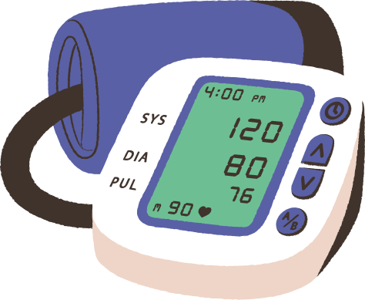
Inference Engine
It evaluates all the rules against the patient’s data.
When conditions match, the rule fires and adds to a disease score.
Multiple rules can combine, increasing confidence.
It also checks red flags like low oxygen or bleeding.
And finally, it ranks the diseases and prepares explanations.
Name:Fatema Afsan Ema ID:2022281642 Name:Md Mashikur Rahaman ID: 201103364 Name: Rakibul Hasan Ridoy ID:1731339042
Name:Nafsi Omar Prokrety ID:2022326642 Name:Mehidi Hasan Khan ID:2013957642

Slide 8



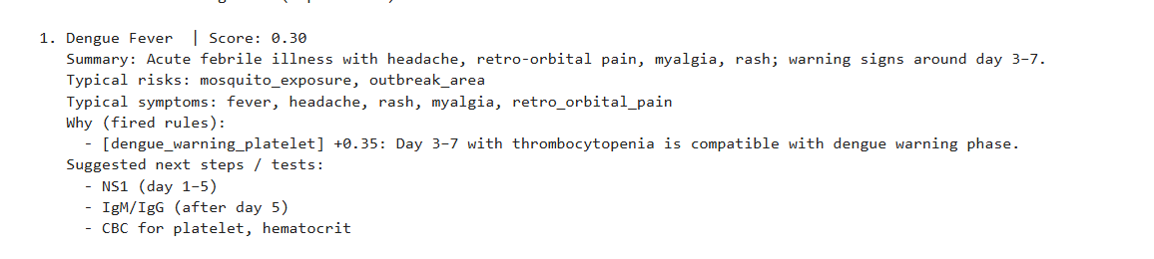
Explainability
Fired rules are listed.
Shows “why” each diagnosis was suggested.
Red flags highlighted for urgent care.
scores: Dict[str, float] = {}
explanations: Dict[str, List[Tuple[str, str, float]]] = {}
fired_rules: List[str] = []
Name:Fatema Afsan Ema ID:2022281642 Name:Md Mashikur Rahaman ID: 201103364 Name: Rakibul Hasan Ridoy ID:1731339042
Name:Nafsi Omar Prokrety ID:2022326642 Name:Mehidi Hasan Khan ID:2013957642

Slide 9

TIMELINE
Week 1–3: Research & Planning
Week 4–6: Knowledge base design, core logic, UI flow
Week 7: Implementation, rules + certainty factor add
Week 8: Testing, output validation, refine diagnosis
Week 9: Add symptom suggestions, confidence scoring
Week 10: Report, slides, documentation
Week 11–12: Demo & submission
Name:Fatema Afsan Ema ID:2022281642 Name:Md Mashikur Rahaman ID: 201103364 Name: Rakibul Hasan Ridoy ID:1731339042
Name:Nafsi Omar Prokrety ID:2022326642 Name:Mehidi Hasan Khan ID:2013957642

Slide 10
FUTURE WORK
Integrate Machine Learning to improve predictions for complex cases.
Enable NLP symptom input for free-text patient descriptions.
Support dynamic updates to the knowledge base with new diseases and rules.
Develop a Web/Mobile interface for easy clinical access. Integrate with EHR sytems for automatic patient data retrieval.
Conduct clinical validation to refine accuracy and usability.
Name:Fatema Afsan Ema ID:2022281642 Name:Md Mashikur Rahaman ID: 201103364 Name: Rakibul Hasan Ridoy ID:1731339042
Name:Nafsi Omar Prokrety ID:2022326642 Name:Mehidi Hasan Khan ID:2013957642

Slide 11


CONCLUSION
The Medical Diagnosis Expert System supports clinicians by providing differential diagnoses, red flag alerts, and test recommendations based on patient symptoms, vitals, and history. Its rule-based, explainable reasoning ensures transparency and
trust, while the modular knowledge base allows easy expansion.This AI-driven system demonstrates the potential to enhance clinical decision-making, improve patient outcomes, and serve as an educational tool in healthcare.ations based on patient symptoms, vitals, and history. Its rule-based, explainable reasoning ensures transparency and trust, while the modular knowledge base allows easy expansion.
OVERVIEW 2
Name:Fatema Afsan Ema ID:2022281642 Name:Md Mashikur Rahaman ID: 201103364 Name: Rakibul Hasan Ridoy ID:1731339042
Name:Nafsi Omar Prokrety ID:2022326642 Name:Mehidi Hasan Khan ID:2013957642

Slide 12
THANK YOU FOR YOUR ATTENTION

